Slide 1
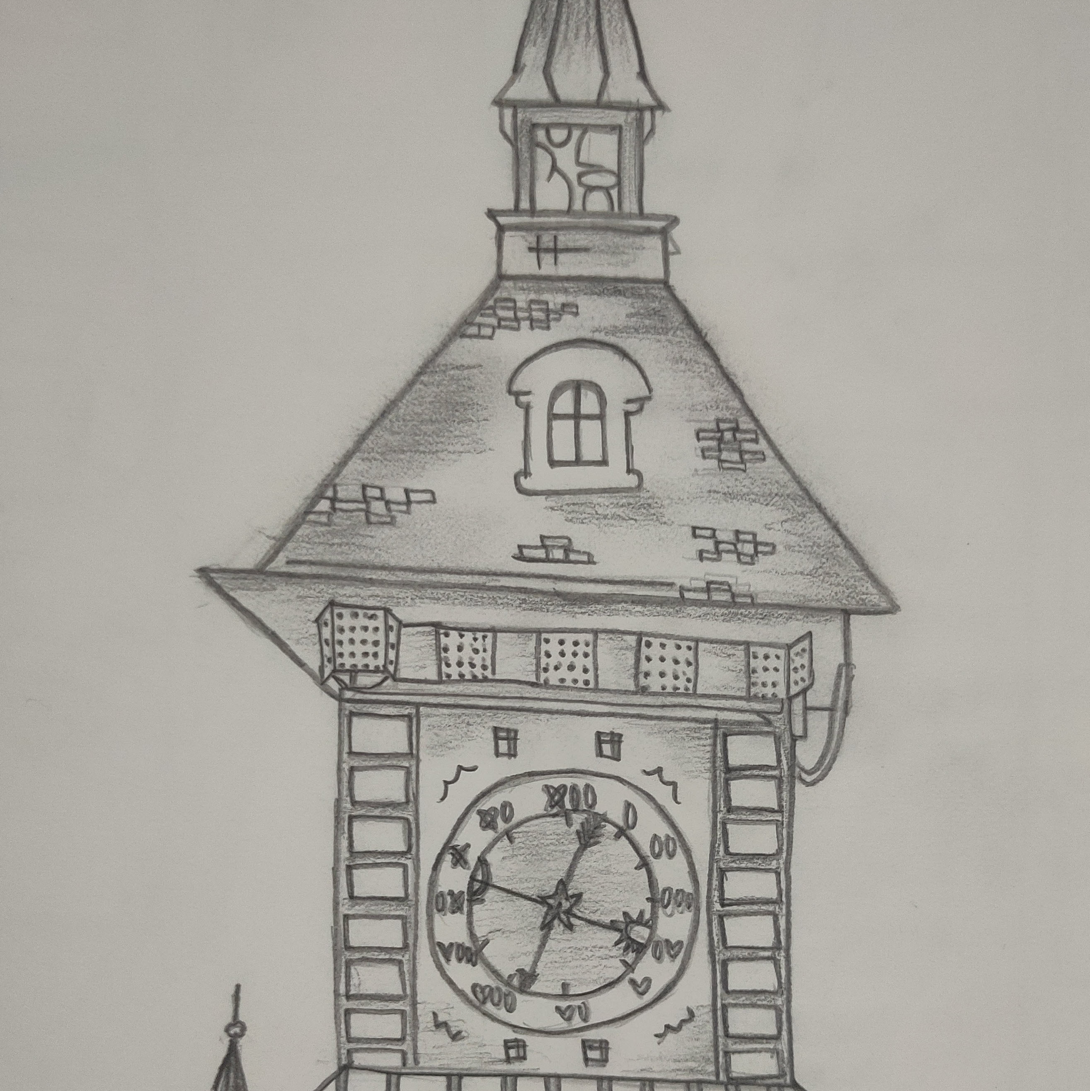
Design Portfolio
An ambitious high-school senior with a flair for design.
Suchita

Slide 2
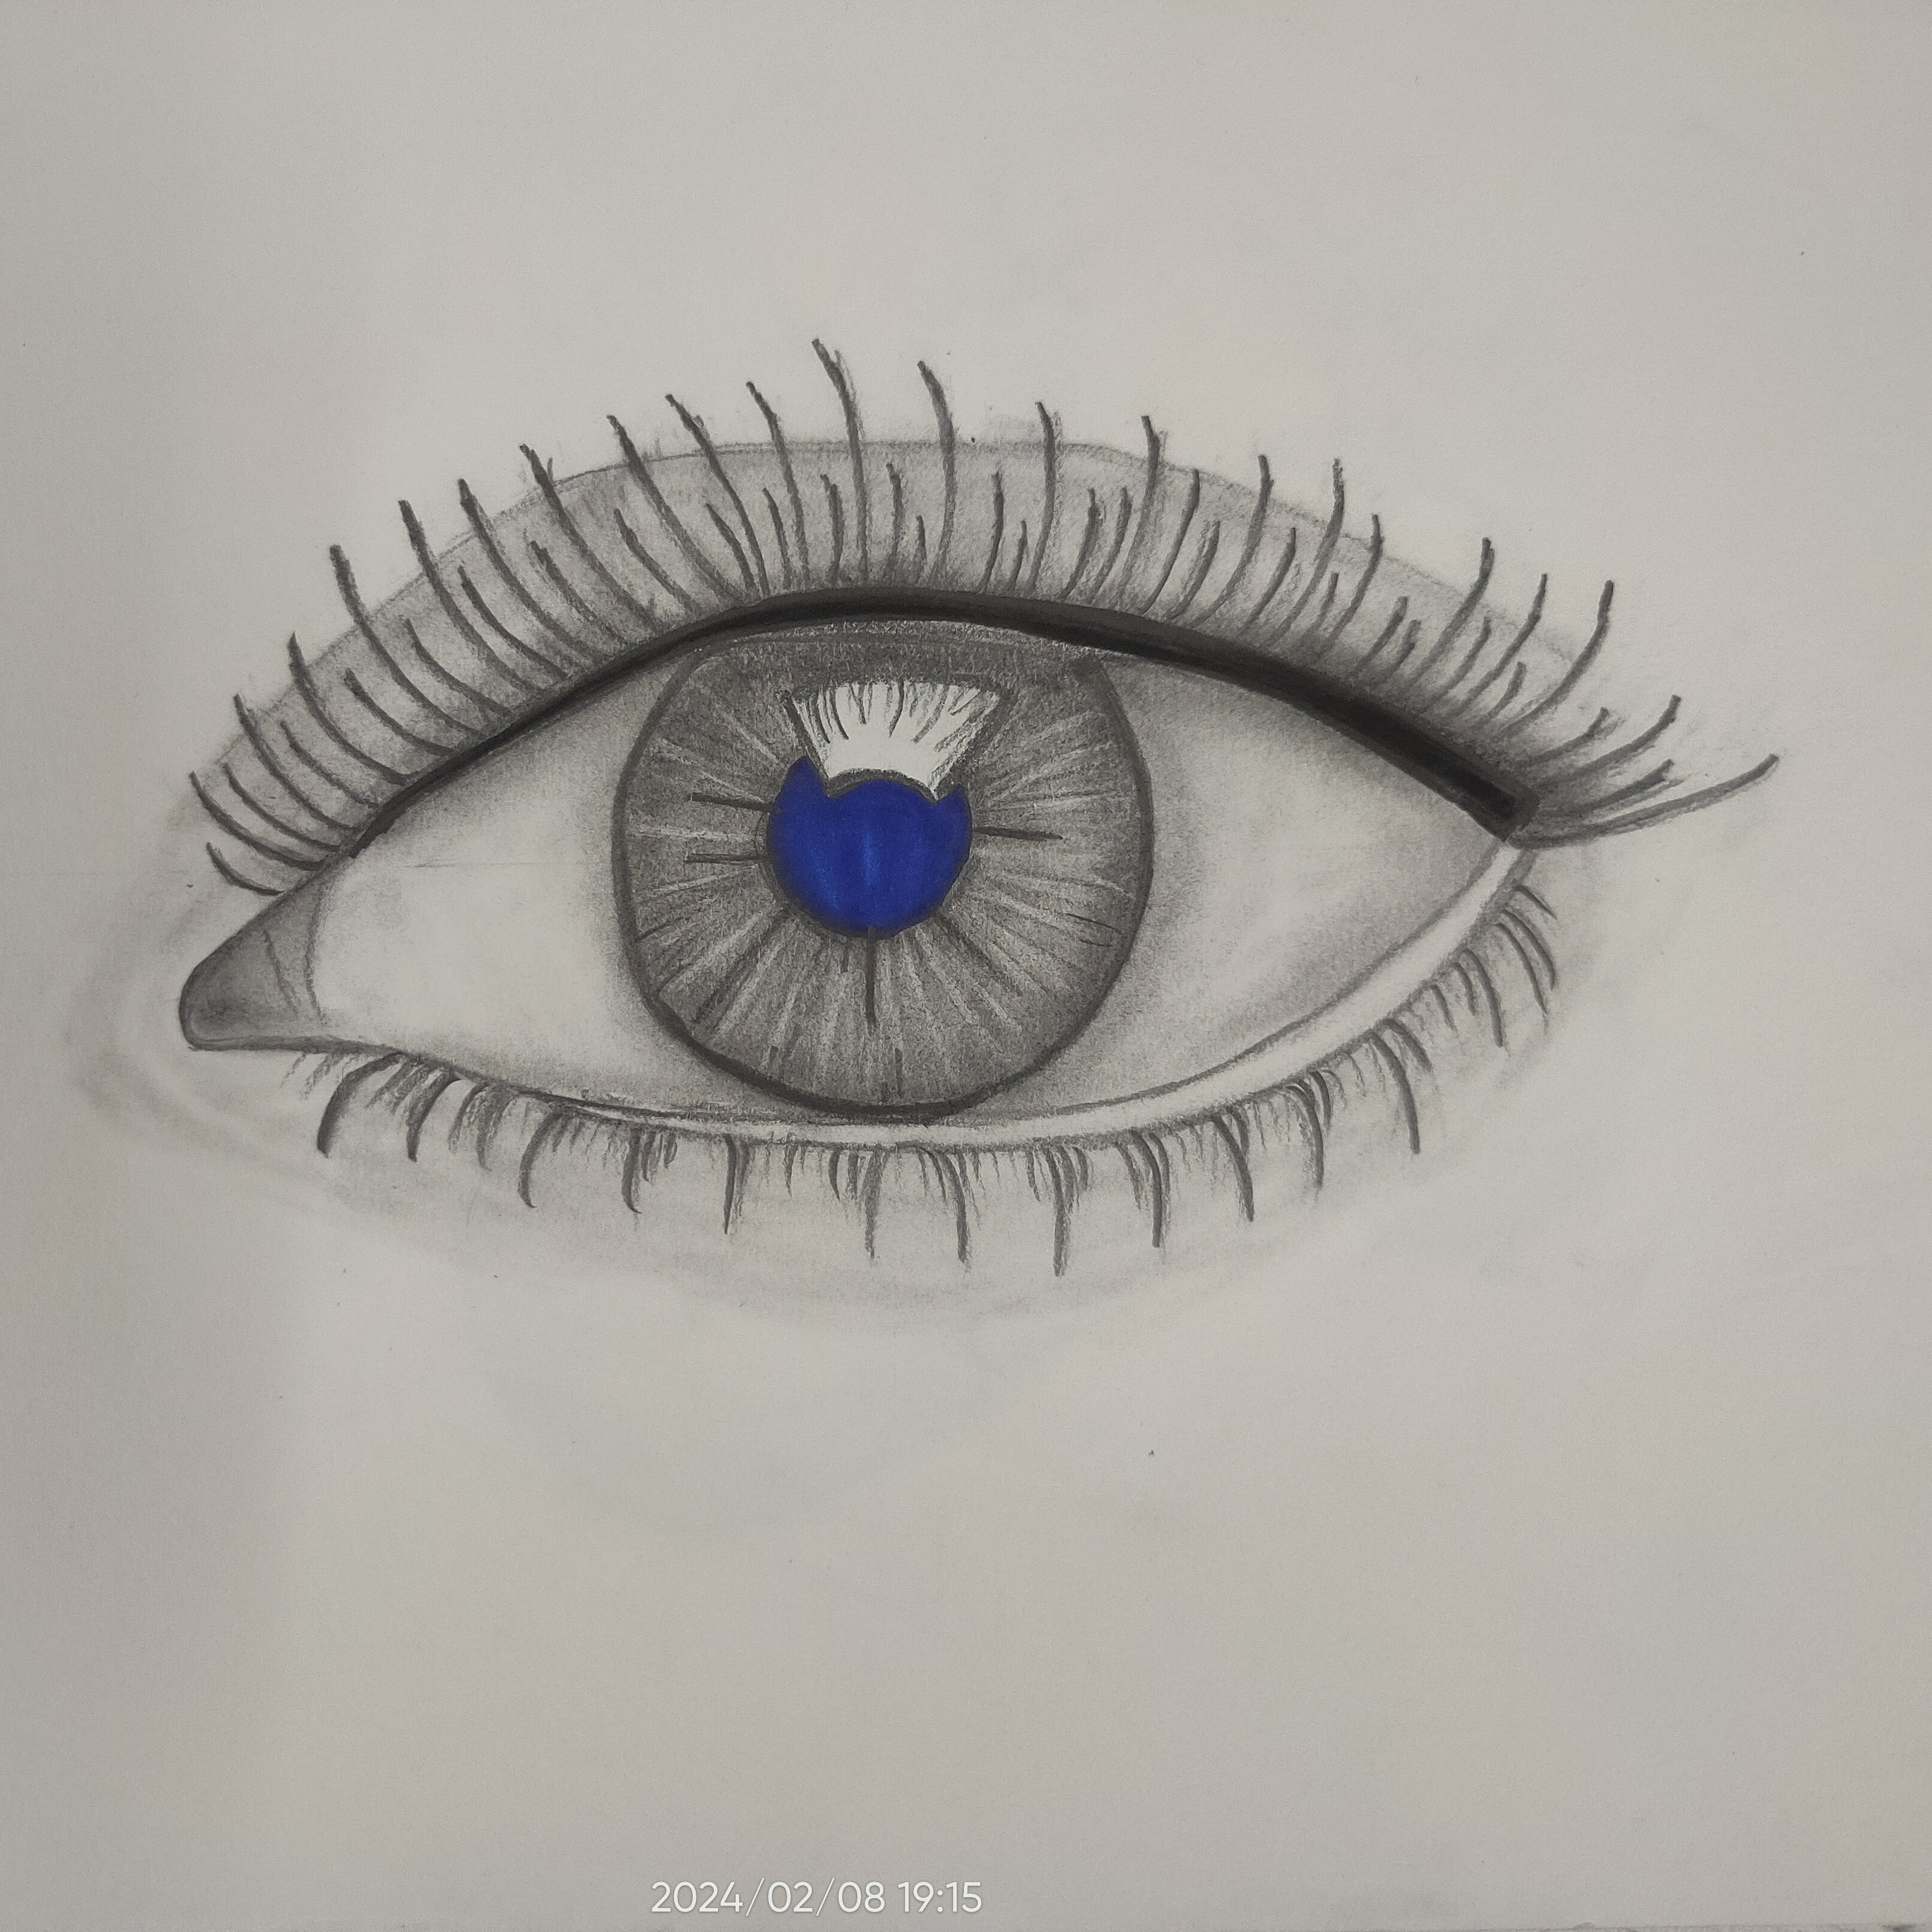
Placeholder Title 01
Realistic Artwork

Slide 3
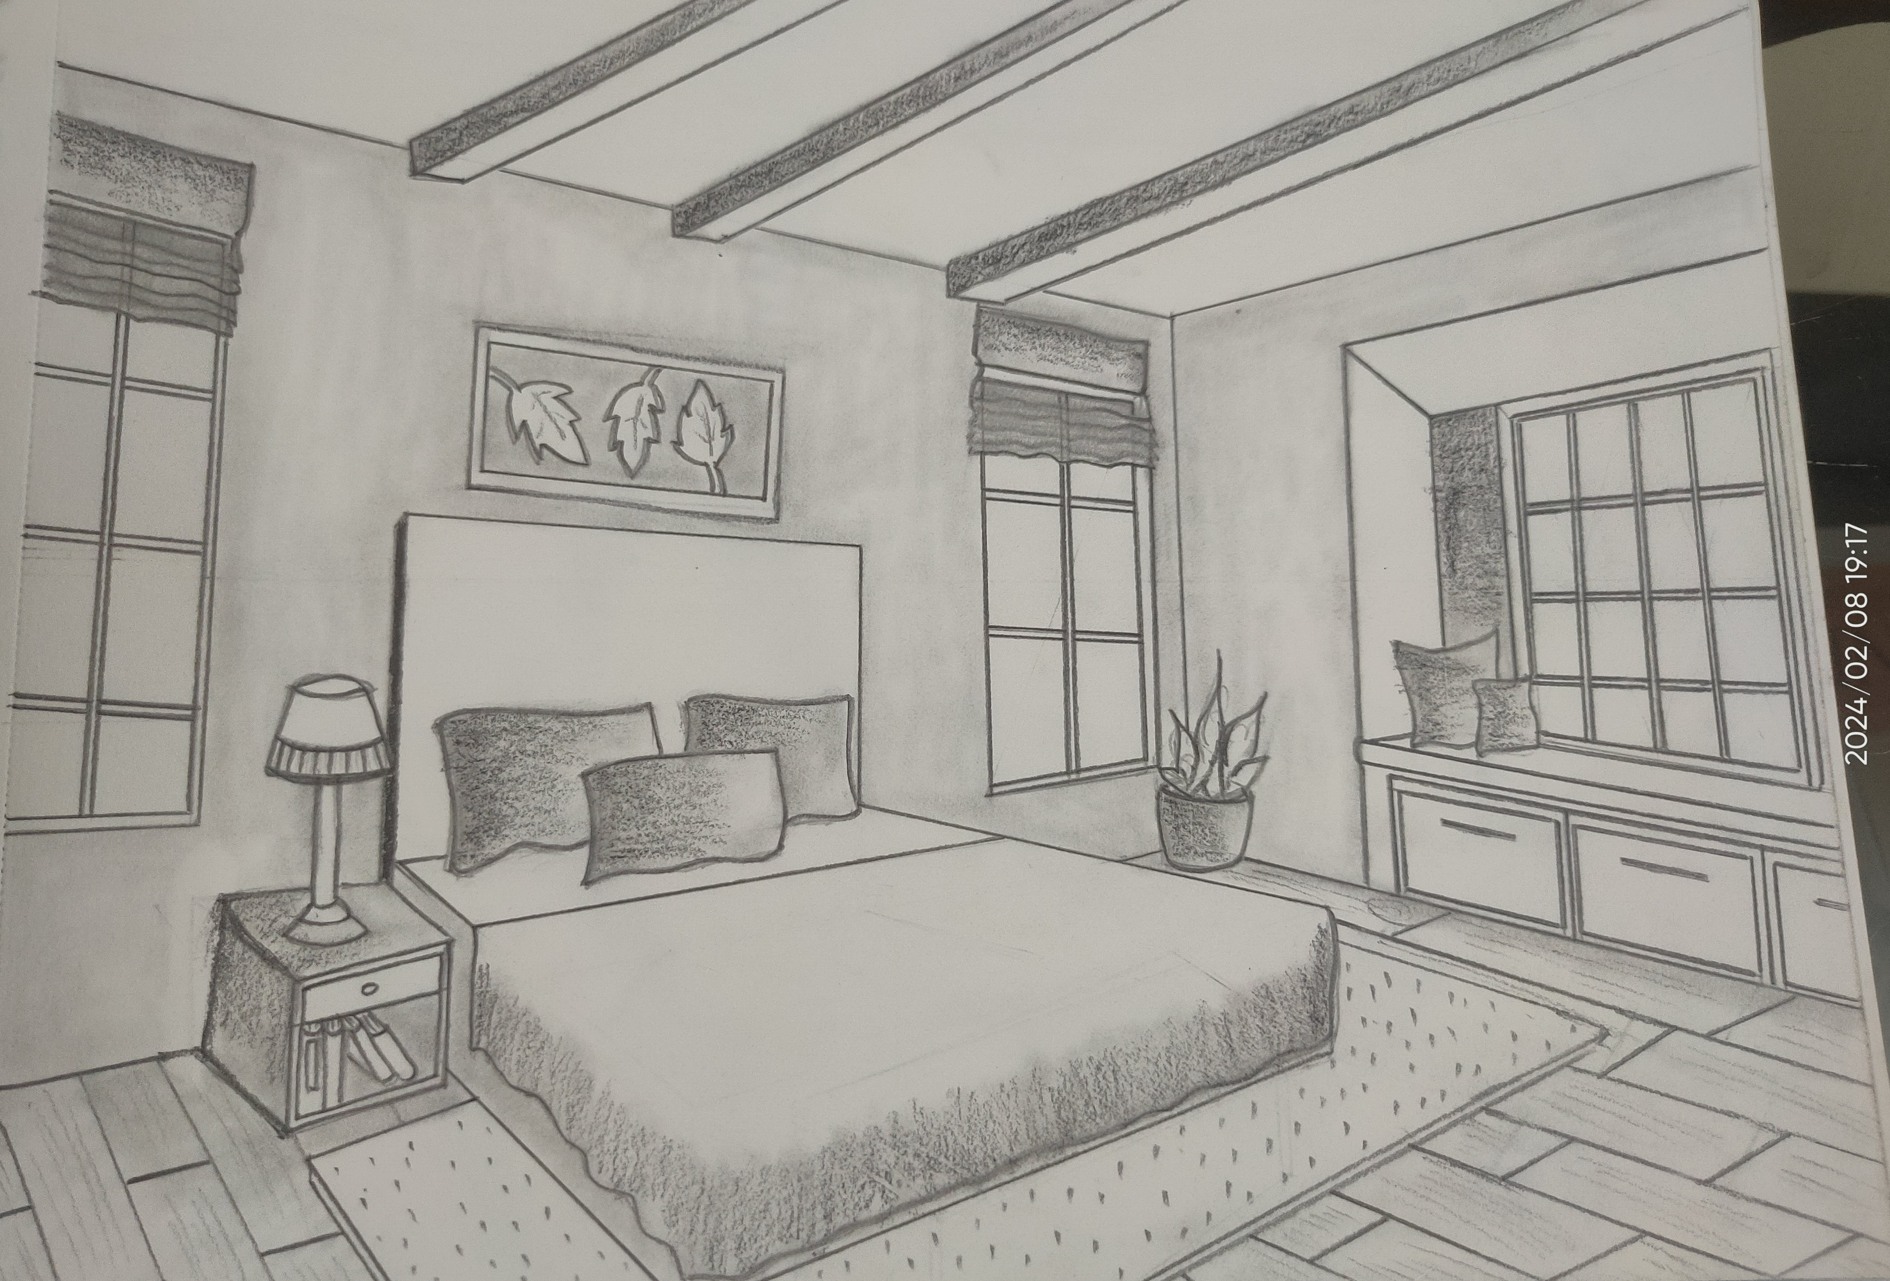
Placeholder Title 04
Perspective Sketch

Slide 4
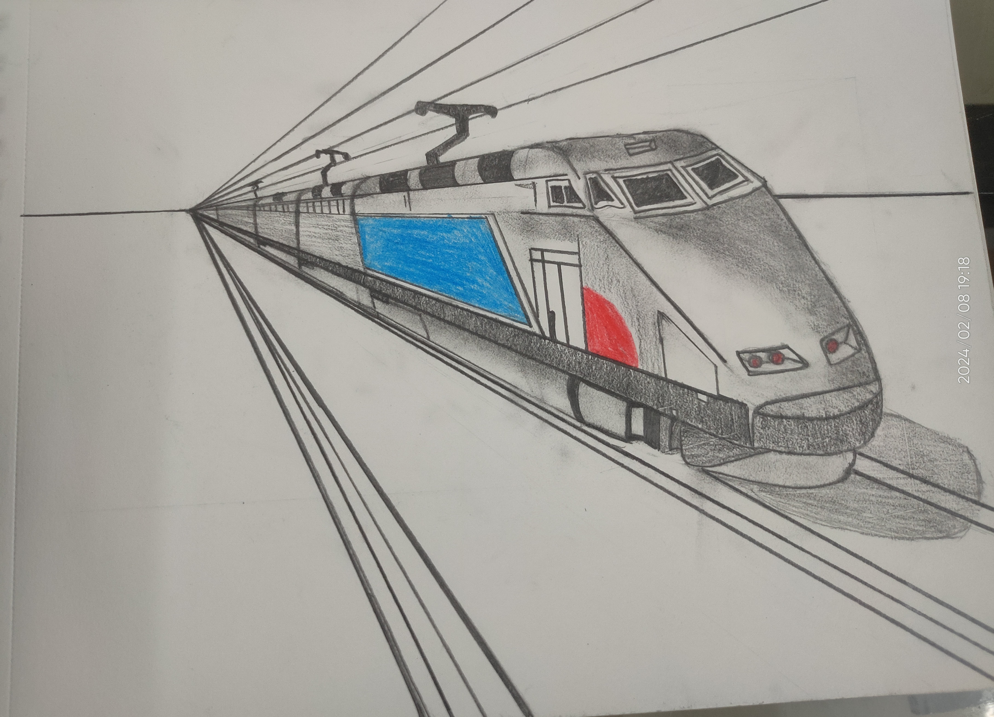
Placeholder Title 04
Perspective Sketch

Slide 5
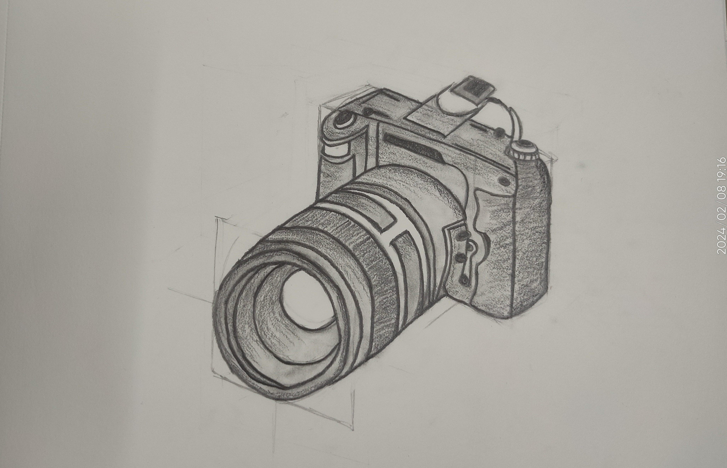
Placeholder Title 04
Product Sketch

Slide 6
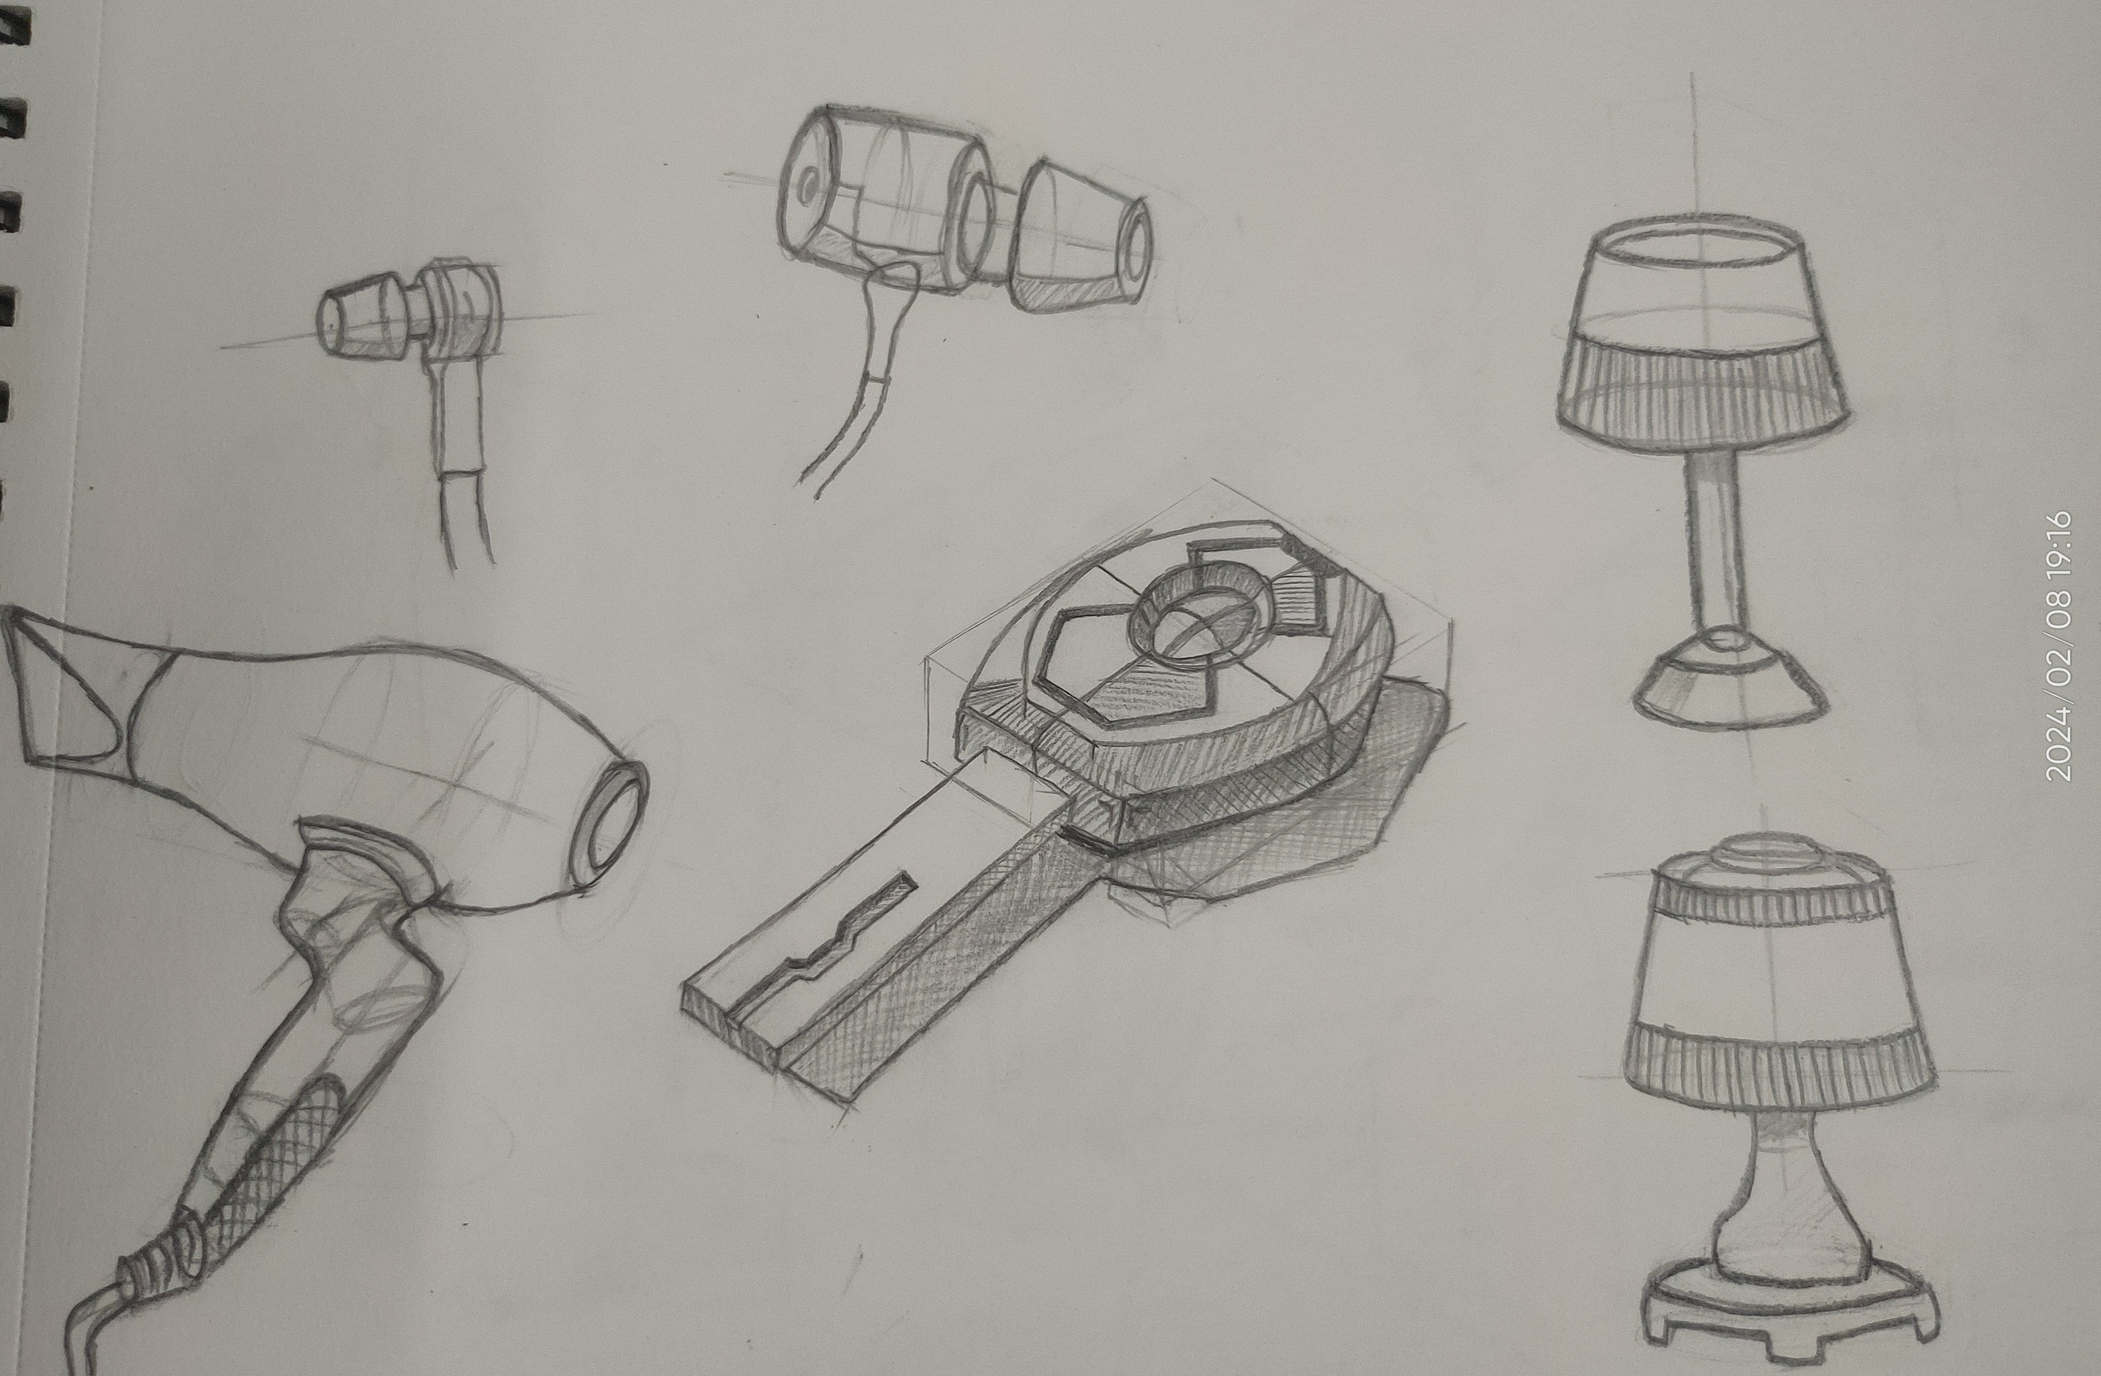
Placeholder Title 04
Product Sketch

Slide 7
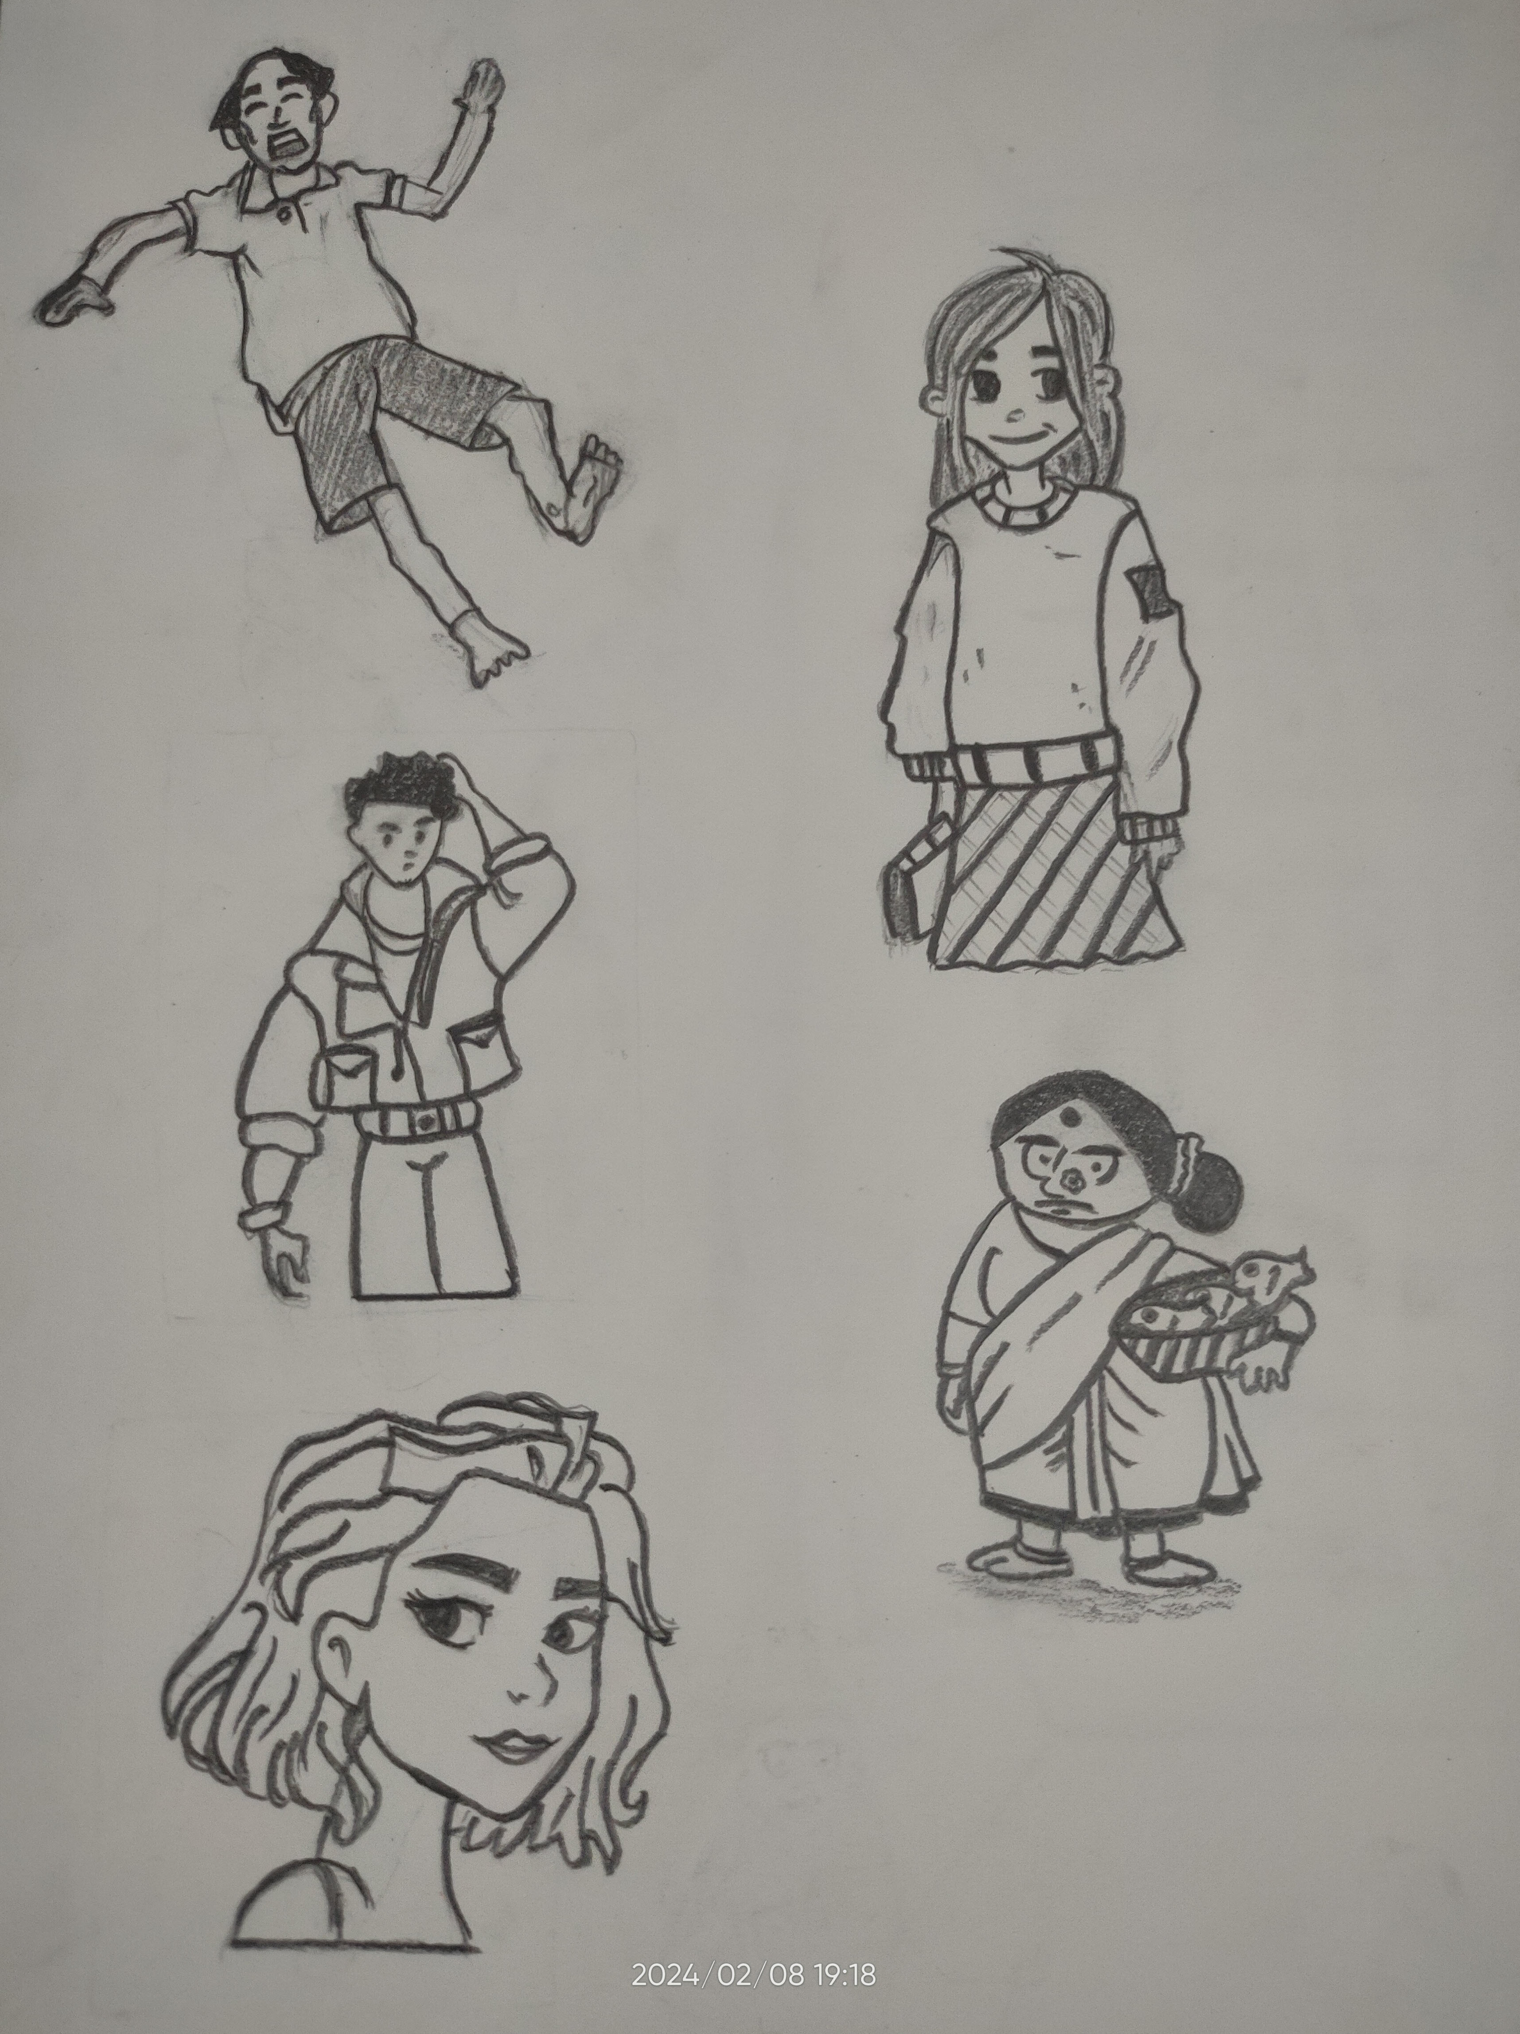
Placeholder Title 08
Character Sketch

Slide 8
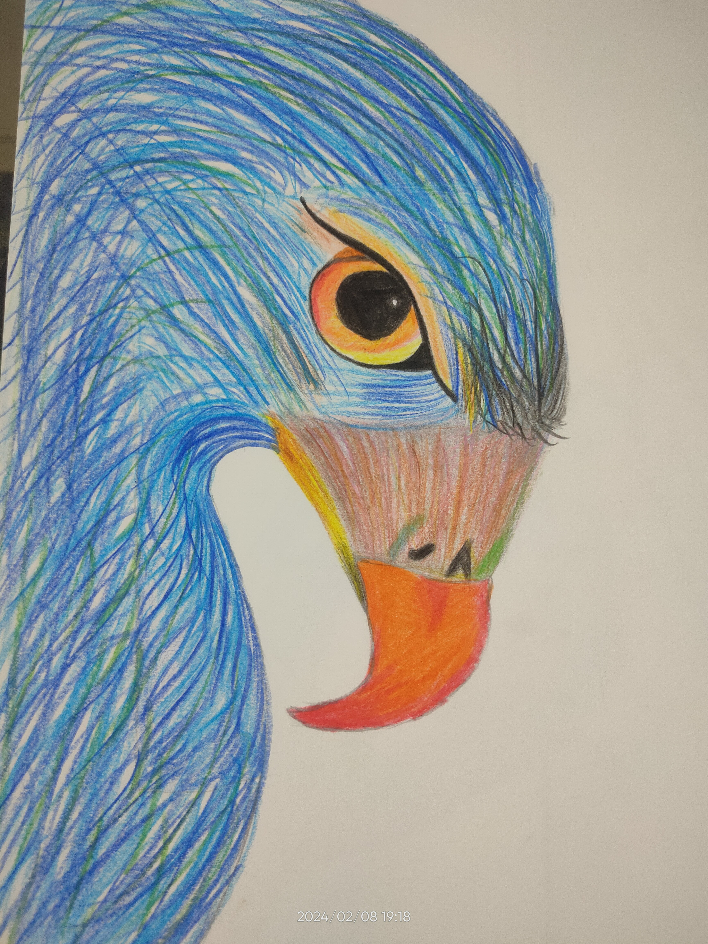
Placeholder Title 08
Color Art

